Slide 1




The Future of Healthcare
PARIS June7-8, 2018
The Next Tech Law Revolution
Jonathan Sternberg | VP Global Business Development, Medix

Slide 2





90
S
E
I
R
T
O
M
E
R
S
T
S
N
U
U
C
O
D
Over
C
E
2m
R
R
Over
F
T
E
A
U
O
T
E
M
S
G
E
N
N
I
N
T
A
43%
H
C
cases
London Hong Kong Shanghai Singapore Tel Aviv
20%
C
O
S
H
F
E
F
I
A
cases
C
N
G
E
O
R
S
O
T
C
F
O
D
D
I
A
O
S
G
I
N
S
Over
1,500
Over
3,000
H
O
S
P
I
T
A
L
S

Slide 3



The Future of Healthcare in a Nutshel
Existing healthcare institutions will slowly be crushed as new business models with better and more efficient care emerge. Thousands of startups, as well as today’s data giants (Google, Apple, Microsoft, SAP, IBM, Alibaba, Tencent, etc.) have entered this lucrative multi trillion $ healthcare industry with new business models that dematerialize, demonetize and democratize today’s bureaucratic and inefficient system
Biometric sensing (wearables) and AI are exponential enablers of managed care. Large-scale whole genomic sequencing and machine learning allows us to better understand the root cause of cancer, heart disease and neurodegenerative disease and what can be done about it
Robotic surgeons can carry out an autonomous surgical procedure perfectly (every time) for pennies on the dollar
Each of us will be able to regrow a heart, liver, lung or kidney when we need it, instead of waiting for the donor to die

Slide 4
Megatrends in Healthcare Explained
Enhanced EMR: Digitalisation, Big Data, AI, Cloud Medicine, Augmented Reality in OR, Tele & Mhealth, Sensor Medicine & Home Care
Genomics: All-Sequencing, Bio-Informatics, Integration of Genomic Data in personal EMR, Targeted and Personalised Medicine, empowerment of
Pharmacogenetics, Genome Editing Techniques, Non-Invasive Cancer Screening
Nanomedicine: Drug Delivery, Theranostics, Nanobiosensors, Nanobots
Medical Robotics
Regenerative Medicine: Cell Therapy & Gene Therapy, Stem Cell therapy, Tissue Regeneration, Bio-printing

Slide 5

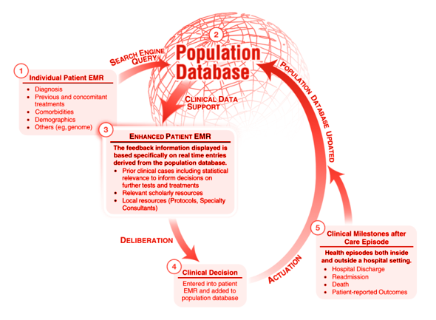

Enhanced EMR – Where does it take us? Digitalisation, Big Data & Artificial Intel igence
Big Data
Artificial Intelligence & Decision S
Cloud Medicine Sensor Medicine Augmented Reality
upport
Holographic Data Input m-Health
Assisted Image analysis
Multi-parameter analysis
Telemedicine and Home-care
Large population analysis

Slide 6
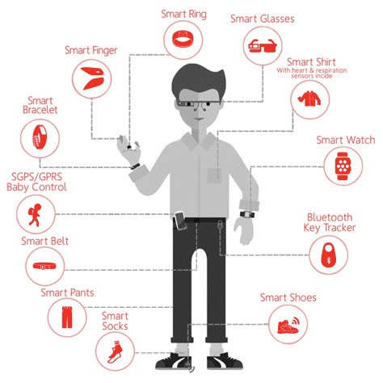
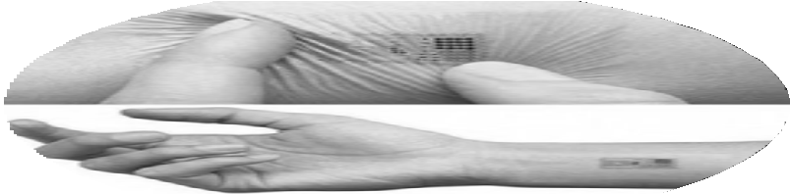
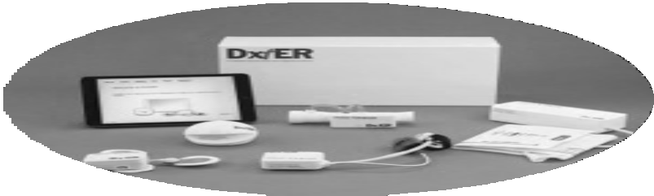
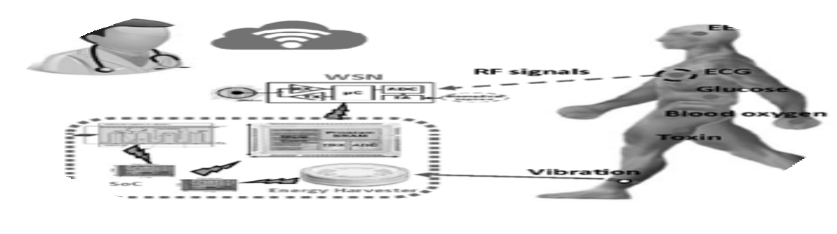
Medical Wearables & Sensors
Home Care & Home Monitoring On-going monitoring of Chronic Patients
Expected 12Billion USD Market Size in 2018

Slide 7
2.
Diagnosis is made via multi-disciplinary discussion with specialists across the world
3.
Surgeon in NYC remotely controls robot to perform surgery on the patient in Paris
4.
Patient recuperates
at home with wearables transmitting vital signs in real-time to the physician
1.
Patient uploads his Genetic Data,
Blood Tests and Scans
Personalisation, Genetic Profiling and Cloud Medicine
Remote Access
and Borderless Care
Robotic Surgery
Wearables and Continuous Monitoring

Slide 8






Accessibility to quality healthcare everywhere
Collaborative Borderless Healthcare Ecosystem
Efficient use of medical resources Healthcare cost sustainability Flattening the Inequality-of-Care curve
However the following issues must be addressed: Privacy
Regulation Liability

Slide 9
Thank You
It's a matter of life

